Slide 1
Windows 7 and Windows Server 2008 R2 Kernel Changes
CL04
Mark Russinovich
Technical Fellow, Windows
Microsoft

Slide 2
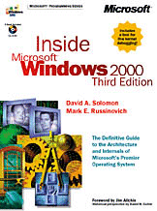
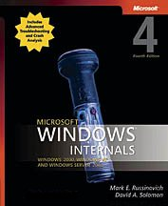
About Me
Technical Fellow, Microsoft
Co-founder and Chief Software Architect of Winternals Software
Co-author of Windows Internals 4th and 5th Edition and Inside Windows 2000 3rd Edition with David Solomon
Creator of Sysinternals Tools
Now hosted on TechNet
Home of my blog and forums Contributing Editor TechNet Magazine, Windows IT Pro Magazine
Ph.D. in Computer Engineering

Slide 3
Scope of the Talk
Talk covers key enhancements to the Windows 7 and Windows Server 2008 R2 kernel and related core components
Performance, scalability, power efficiency, virtualization, security…
Many other significant improvements not covered:
New taskbar (Superbar), DirectX enhancements including D2D, DWrite and DirectCompute, Home Group, Branch Cache, DirectAccess, Device Stage, PowerShell v2 and Troubleshooting Packs, User-mode Scheduling, Virtualization

Slide 4
The Kernel
Windows 7 and Server 2008 R2 based on same kernel
As planned, Server 2008 R2 is 64-bit only
Wow64 is an optional component on Server Core
6.1 version number for application compatibility
Does not reflect number of major Windows NT-based releases
Does not reflect amount of change in the system
Anticipated that many applications would check for Vista major version (6) at the time of release

Slide 5
Agenda
Componentization and Layering
Performance
Power Efficiency
Reliability
Security
Native VHD
Virtualization
Scalability

Slide 6
MinWin
MinWin is first step at creating architectural partitions
Can be built, booted and tested separately from the rest of the system
Higher layers can evolve independently
MinWin was defined as set of components required to boot and access network
“Cutler’s NT”: Kernel, file system driver, TCP/IP stack, device drivers, services
No servicing, WMI, graphics, audio or shell
MinWin footprint: 150 binaries, 25MB on disk, 40MB in-memory

Slide 7
MinWin Layering
Shell,
Graphics,
Multimedia,
Layered Services,
Applets,
Etc.
Kernel,
HAL,
TCP/IP,
File Systems,
Drivers,
Core System Services
MinWin

Slide 8
DLL Refactoring
Required some DLLs to be “refactored” to remove dependencies on higher layers
Applications outside of MinWin use legacy DLLs
DLLs forward calls to MinWin APIs into MinWin DLLs
Example:
Kernel32.dll -> Kernelbase.dll
Advapi32.dll -> Kernelbase.dll

Slide 9
API Sets
Problem: DLLs contain multiple API sets
Ties API contracts with DLL implementation
API Sets are virtual DLLs
Internal API architecture is separated from implementation
Virtual DLLs can be combined at build time for efficiency
MinWin APIs first ones factored into virtual DLLs:
E.g. api-ms-win-core-errorhandling-l1-1-0.dll
Numbers are layer in the system, major and minor version of API

Slide 10
Mapping Virtual DLLs to Logical DLLs
The mapping of virtual to logical is stored in a schema that’s embedded in Apisetschema.dll
Kernel reads schema during boot and maps it into every process for quick lookup
Loader refers to schema for DLL loads that are pathless to find mapping
Virtual DLLs images present on system for application compatibility with tools like Dependency Walker
Not used by loader
Loader
Virtual DLL 1
ApiSetSchema.dll
Logical DLL
Virtual DLL 2

Slide 11
Console Window Support
As part of re-architecture, Windows message loop for cmd.exe moved into Conhost.exe
Was in Csrss.exe
Also closes User Interface Privilege Isolation hole
Conhost processes keyboard input
Is child of Csrss.exe
Cmd.exe processes commands

Slide 12
Agenda
Componentization and Layering
Performance
Power Efficiency
Reliability
Security
Native VHD
Virtualization
Scalability

Slide 13
Client Footprint Reduction
Over 400 footprint reductions across all components
MB

Slide 14
Server Footprint Reduction

Slide 15
Memory Optimizations
DWM re-architecture reduces memory footprint per window by 50%
Registry read into paged pool
Was memory mapped before
Improves performance because views into registry file don’t need to be mapped and unmapped

Slide 16
Working Set Improvements
Memory manager tuned to reduce impact of run-away processes
Processes that grow quickly reuse their own pages more aggressively
Uses 8 aging levels (3-bits) instead of 4 (2-bits)
System cache, paged pool, and pageable system code now each have own working set
Now, each tuned according to specific usage, which improves memory usage
Reduces impact of file copies on system code
Vista, Server 2008
System Cache, Paged Pool, System Code
P1
P2
…
Windows 7, Server 2008 R2
System Cache
Paged Pool
System Code
P1
P2
…

Slide 17
PerfTrack
PerfTrack: 300 user-visible scenarios identified
Examples: open start menu, open control panel, booting
Performance goals set for each feature
Instrumented with begin/end events
Data sampled from Customer Experience Program and fed back to feature teams
Great
OK
Bad
Click Start Menu
Start Menu Open

Slide 18
ReadyBoost/ReadyBoot Improvements
Kernel-mode Store Manager for tighter integration with Memory Manager
Can now cache pagefile-backed pages
Support for 32 GB cache (4 GB in Vista)
Better security with AES256 encryption
Improved ReadyBoot to speed up boot
Reduced memory usage such that it can run on machines < 1GB
Compression disabled for machines > 1.7GB to save CPU

Slide 19
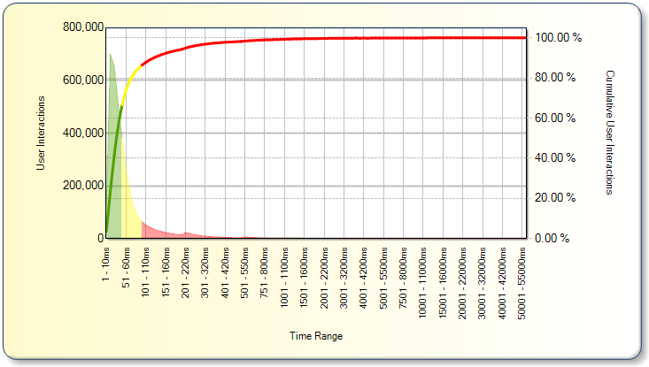
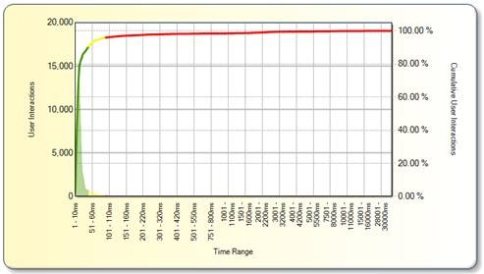
PerfTrack – Start Menu
Build 7000
Build 7033

Slide 20
Agenda
Componentization and Layering
Performance
Power Efficiency
Reliability
Security
Native VHD
Virtualization
Scalability

Slide 21
Keys to Power Efficiency
Keep idle and stay idle
Minimize running services and tasks
Avoid background processing
Let LPs and sockets stay idle so that they enter deep sleep (C states)
+10% CPU = +1.25W
+1.25W = -8.3% battery

Slide 22
Core Parking
Before, CPU workload distributed fairly evenly across LPs
Even if utilization low
Core Parking tries to keep load on fewest LPs possible
Allows others to sleep
Is aware of socket topology
Newer processors put sockets into deep sleep if cores are idle
Core Parking active on server and SMT (hyperthreaded systems only)
Best returns on medium utilization workloads
Clients tend to run at extremes (0 or 100)

Slide 23
Core Parking Design
Power management timer fires periodically (30-50ms)
Performs P-state management
Calculates average utilization and implements core parking policy
Determines which LPs to “park” and which to “unpark”:
Unpark cores if average for unparked is > increase threshold
Park cores if average for unparked < decrease threshold
Parked cores above parking threshold also unparked
At least one CPU in each NUMA node left unparked
Power manager notifies scheduler of updated parking decision
Scheduler avoids parked cores
Overridden by hard affinity and thread ideal processor if no others available
Interrupts and DPCs not affected

Slide 24
Core Parking Operation
Core 0
Core 1
Core 0
Core 0
Core 0
Core 1
Core 1
Core 1
Socket 0
Socket 1
Workload

Slide 25
Unified Background Process Manager (UBPM)
UBPM infrastructure unifies mechanism for event-based process start and stop
Implemented in Service Control Manager to avoid creating another process
All events are based on ETW events
UBPM is a central manager of ETW consumer registration and notification
UBPM clients:
Task scheduler: new Taskhost processes
Service Control Manager: trigger-started services

Slide 26
Trigger-Started Services
Before, services typically started at system boot and ran until shutdown
Services can now specify specific start and stop conditions (triggers):
Device class arrival and removal
Bthserv: start on bluetooth device class arrival
IP address arrival and removal
Lmhosts: start on first and stop on last IP address availability
Firewall port event
Browser: open of NS and DGM ports
Domain join and unjoin
W32Time: start on join, stop on unjoin
Custom ETW event
EFS: start on first encrypted file access
Triggers are stored in service registry key
Use “sc qtriggerinfo” to view service triggers

Slide 27
Timer Coalescing
Staying idle requires minimizing timer interrupts
Before, periodic timers had independent cycles even when period was the same
New timer APIs permit timer coalescing
Application or driver specifies tolerable delay
Timer system shifts timer firing to align periods on natural frequency
Timer tick
15.6 ms
Vista
Periodic Timer Events
Windows 7

Slide 28
Intelligent Timer Tick Distribution
Before, primary timer interrupt on LP 0 propagated timer to all other LPs
LP0 timer updates system tick count and clock
Timer interrupt for all LPs updates process and thread runtimes, checks for thread quantum end
Even if LP was idle, it had to service interrupt
Now, timer system propagates timer only to processors that aren’t idle
Also called tick skipping
Non-timer interrupts still wake LP

Slide 29
Other Power Improvements
Timer reduction:
Eliminated TCP DPC timer on every system timer interrupt
Reduced frequency of USB driver maintenance timers
Device power management:
Support for latest Intel HD Audio low-power specifications
Bluetooth radio enters selective suspend when connections are in sniff mode
NIC automatically enters D3 when media is disconnected
Powercfg tool for managing performance policies
Has /energy option for identifying power efficiency issues

Slide 30
Analysis: Length of Idle Intervals
Windows* Vista SP1
Windows* 7 Build A
Windows* 7 Build B
Move right better
%idle time (per core Avg.)
Notes:
30

Slide 31
Agenda
Componentization and Layering
Performance
Power Efficiency
Reliability
Security
Native VHD
Scalability

Slide 32
Fault Tolerant Heap (FTH)
Heap corruption is a major cause of unreliability
15% of all user-mode crashes
30% of user-mode crashes during shutdown
Very difficult to analyze and fix
FTH reduces impact of heap misuse
Monitors for heap corruption crashes
Applies mitigations dynamically
Removes mitigation if unsuccessful
Returns debug information for use by ISVs

Slide 33
FTH Activation and Operation
After a process crash, FTH starts watching for additional crashes
If process crashes four times in the next hour in Ntdll.dll, FTH applies appcompat shim
Once shim applies, shim assigned weight and FTH monitors for successful mitigations
If process crashes or mitigations not applied, shim weight reduced
If process survives and mitigation applied, shim weight increased
If shim weight goes below zero, shim removed
FTH shim operation:
Validates all heap operations using native heap
Keeps 4MB of freed buffers to mitigate double-frees
Pads allocations < 4096-8 bytes by 8 bytes

Slide 34
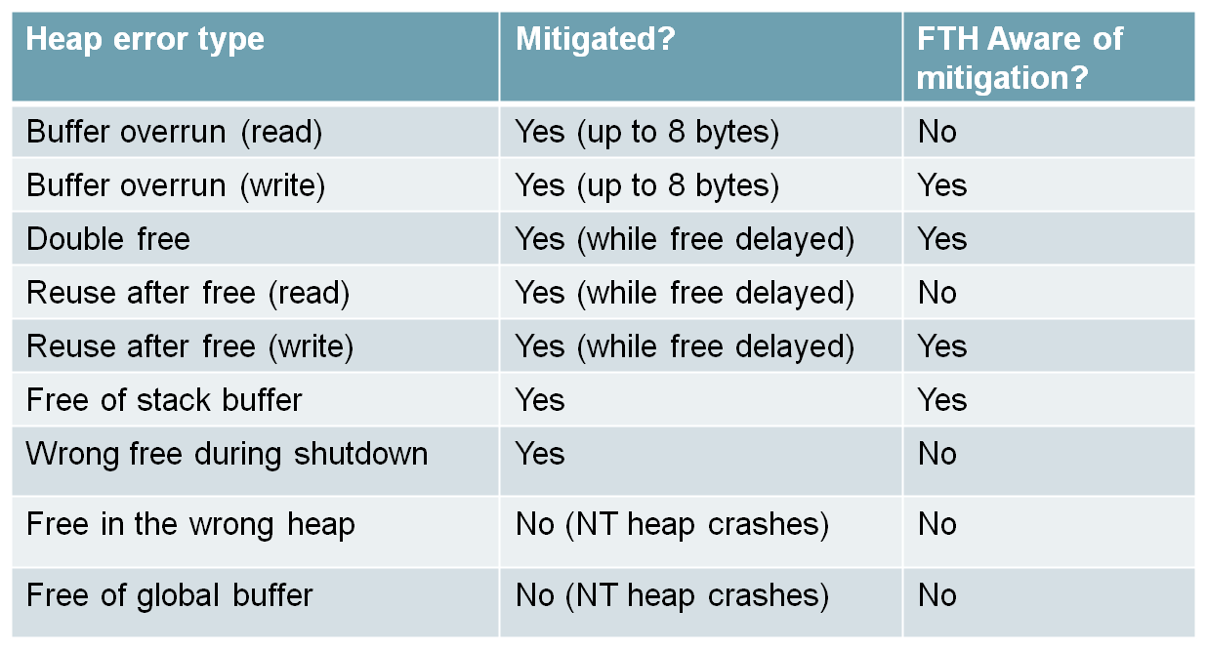
FTH Mitigations

Slide 35
Process Reflection
Problem: want to capture dumps of processes that appear hung or that have leaked memory
Don’t want to terminate process
Don’t want to suspend process for lengthy dump operation
Don’t want to scan device memory
Process Reflection creates clone of process for dump and analysis
Modeled on native fork() support
Makes copy that’s safe to memory scan
Used by leak detection diagnostic
Used by cross-process hang detection diagnostic

Slide 36
Agenda
Componentization and Layering
Performance
Power Efficiency
Reliability
Security
Native VHD
Virtualization
Scalability

Slide 37
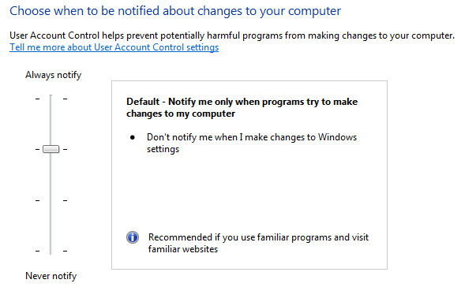
User Account Control Levels
Windows 7 introduces 2 new UAC levels
User can tune notification versus convenience
Applies to protected-administrator only

Slide 38
User Account Control Levels
High: Vista equivalent
Prompts for: all elevations
Prompts on: secure desktop
Medium: default
Prompts for: non-Windows elevations
Windows means:
Signed by Windows certificate
In secure location
Doesn’t accept control command-line (e.g. cmd.exe)
Prompts on: secure desktop
Low:
Prompts for: non-Windows elevations
Prompts on: standard desktop
Avoids black flash and user can interact with desktop
Possible appcompat issues with 3rd-party accessibility applications
Off: UAC off
No Protected Mode IE
No file system or registry virtualization

Slide 39
Virtual Accounts
Want better isolation than existing service accounts
Don’t want to manage passwords
Virtual accounts are like service accounts:
Process runs with virtual SID as principal
Can ACL objects to that SID
System-managed password
Show up as computer account when accessing network
Services can specify a virtual account
Account name must be “NT SERVICE\<service>”
Service control manager verifies that service name matches account name
Service control manager creates a user profile for the account
Also used by IIS app pool and SQL Server

Slide 40
Managed Service Accounts
Services sometimes require network identity e.g. SQL, IIS
Before, domain account was only option
Required administrator to manage password and Service Principal Names (SPN)
Management could cause outage while clients updated to use new password
Windows Server 2008 R2 Active Directory introduces Managed Service Accounts (MSA)
New AD class
Password and SPN automatically managed by AD like computer accounts
Configured via PowerShell scripts
Limitation: can be assigned to one system only

Slide 41
BitLocker
Vista introduced BitLocker Drive Encryption
Encrypts fixed volumes
Multiple ways to store key:
TPM, PIN, USB key, multi-factor
Uses a volume filter driver so that encryption is transparent to system
Windows now BitLocker ready
Always creates hidden 200 MB system partition

Slide 42
BitLocker-to-Go
Windows 7 adds support for removable media
Key is protected by password or smartcard
Virtual FAT volume with drive decrypting utility makes volume accessible down level

Slide 43
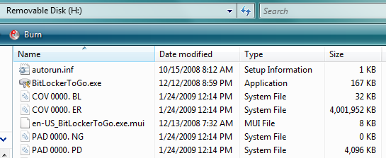
BitLocker-to-Go Format
View on Down-Level System

Slide 44
Windows Biometric Framework (WBF)
WBF standardizes the way that biometric support software plugs into the system
E.g. fingerprint swipe, retina scan
Takes burden off of IHV and standardizes interfaces and UX
WBF includes:
Core platform
Management components
UX components

Slide 45
Other Security Enhancements
Object auditing improvements:
Global access object auditing
Reason auditing:
Logging of ACE (Access Control Entry) that caused allow or deny
Requires Handle Manipulation auditing
App Locker
Kernel enforcement of policy
More flexible image identification (e.g. certificates)

Slide 46
Agenda
Componentization and Layering
Performance
Power Efficiency
Reliability
Security
Native VHD
Virtualization
Scalability

Slide 47
Native VHD Support
Foundational support for booting from VHD and for Surface/Removal of VHDs
Orderly shutdown of volumes
Support for nested volumes (2 levels)
Servicing for mounted (offline) VHD volumes
VHD operations
Create / Attach/ Detach
Meta-operations: Merge, Expand, Compact
Tools and APIs:
Win32 APIs
VDS APIs (DCOM Remotable)
Hyper-V WMI for management operations
Performance goal: within 10% of native

Slide 48
Native VHD Architecture
User / Management Application
Win32 xxxVirtualDisk()
[Create, Surface, Remove, Merge, Compact, Convert]
Diskmgmt.msc
Diskpart.exe
VDS APIs
*HYPER-V WMI
Virtual Volume Stack
Physical Volume Stack
FS Depends
FS Depends
Partmgr
FS
FS
Disk
Volmgr
Volmgr
VHD Driver
*Requires installation of Hyper-V role

Slide 49
Native VHD Performance

Slide 50
VHD Boot
Strategic direction for Windows in the Data Center
Image consolidation
Single image format for generalized and specialized physical images
Single generalized master image for virtual and physical environments
Reduced management TCO
Single toolset and process for management and deployment
Enables other compelling scenarios
Rapid provisioning and repurposing
Rapid, reliable patching and rollback

Slide 51
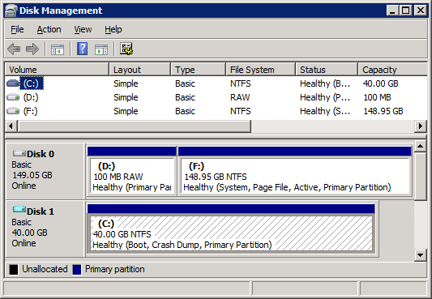
VHD Boot in Windows
Windows
C:\
D:\
VHD

Slide 52
Agenda
Componentization and Layering
Performance
Power Efficiency
Reliability
Security
Native VHD
Virtualization
Scalability

Slide 53
Overview of Server 2008 R2 Hyper-V Scaling Improvements:
Virtualization Feature | WS08 Hyper-V RTM | WS08 Hyper-V SP2 | Windows Server 2008 R2 Hyper-V
Logical Processor Support | 16 | 24 | 64
Total number of powered on VM’s | 128 | 192 | 384
Total Virtual Processors Supported | 128 | 192 | 512
Guest Virtual Processor Support | 4 (WS08 only) | 4 (WS08 only) | 4 (Win7/WS08)
Many performance and scalability improvements
Lock free algorithms
Distributed data structures

Slide 54
VM Migration
Planned VM migration scenarios:
Hardware maintenance
Load balancing for performance
Consolidation for power
Windows Server 2008 includes Quick Migration
VM stored on SAN managed by Microsoft Cluster Services
Suspend of VM on one system to shared disk followed by resume on another
Outage is time it takes to save and restore VMs memory

Slide 55
Live Migration
Live Migration migrates a running VM with minimal disruption of the VMs services
Goal is that open TCP/IP connections do not timeout
Live Migration steps:
Establish connection between source and target host
Transfer VM configuration and device information
Transfer VM memory
Suspend source VM and transfer state
Resume target VM

Slide 56
Live Migration Operation
time
Source
Host
Target
Host
Migration
Setup
Memory
Transfer
State
Transfer
VM Running

Slide 57
Live Migration Internals
Worker process on source host creates “dirty bitmap” of memory pages
Iterates over pages, sending them to target worker process
Registers for modify-notifications on pages to detect subsequent changes
Source VM still active and can be modifying memory
Repeats over newly modified pages
Stops iterating when one of the following:
All pages sent
Makes 5 passes

Slide 58
Live Migration Operation
Memory
Configuration
Configuration
State
State
Server 1
Server 2

Slide 59
High Available Storage and Virtualization
Traditional HA storage is ‘shared nothing’ where one node exclusively owns a LUN
Shared nothing has major disadvantages for virtualization management and high availability
One VM per LUN requirement causes LUN explosion
Management headache
Disruptive delays when LUN ownership changes
Physical disk resource must fail over
Old owner must dismount and new owner must mount volume
Not suitable for Live Migration

Slide 60
Clustered Shared Volumes
Clustered Shared Volumes (CSV) implements hybrid sharing for LUNs
One node owns the storage namespace (e.g. directory structure) and metadata
Other nodes can own the storage backing an individual file’s data (e.g. VHD)
Benefits of CSV:
Can store all VM VHDs on one LUN
High-performance access to VHDs from owning nodes
All nodes have read/write access to file data
Seamless VM movement between nodes
Any node can read from VHD, so no need to change LUN ownership
Seamless LUN ownership transition
Persistent handles allow cluster to move LUN without interruption to VM operation

Slide 61
Clustered Shared Volume Implementation
CSV filter driver forwards all namespace operations (e.g. create file, delete file, resize file) to LUN owner
These operations are relatively rare
Uses SMB2
VM hosting node opens VHD for exclusive access
VHD read and write is frequent
CSV filter obtains raw LUN sector map of file
Reads and writes directly to underlying volume

Slide 62
Clustered Shared Volumes Architecture
CreateFile
VM
File Server Service
CSV I/O Filter Driver
CSV I/O Filter Driver
Redirector FSD
NTFS
NetFT
NetFT
Storage Drivers
Storage Drivers
LUN
LUN Owner
VHD

Slide 63
Clustered Shared Volumes Architecture
Read/WriteFile
VM
File Server Service
CSV I/O Filter Driver
CSV I/O Filter Driver
Redirector FSD
NTFS
NetFT
NetFT
Storage Drivers
Storage Drivers
LUN
LUN Owner
VHD

Slide 64
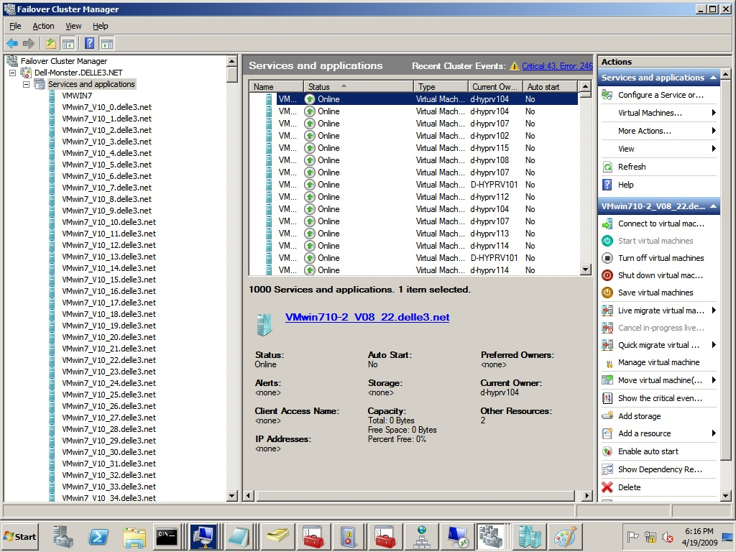
CSV Scalability
1000 VMs running on a 16-node cluster with 16.5 TB shared storage:

Slide 65
VM Memory Management
Today, processors provide one level of address translation, but hypervisor needs to manage two
Guest Virtual Address
Guest Virtual Address
Guest OS defines GVA-to-GPA mappings
Shadow page tables combine these mappings because the processor knows how to perform only one level of translation
Guest Physical Address
Hypervisor defines GPA-to-SPA mappings
System Physical Address
System Physical Address

Slide 66
Shadow Page Tables
Hypervisor maintains a Shadow Page Table
Combines two layers of translation into a single page table
Demand-filled when Child OS touches a page
Flushed any time the Child OS modifies its page tables
Shadow Page Table overhead:
Fills and flushes invoke the hypervisor
Can account for up to 10% of total CPU time
Typically consumes 10-30 MB of memory per VM

Slide 67
Second Level Address Translation (SLAT)
Goes by several names:
Intel calls it Extended Page Tables (EPT)
AMD calls it Nested Page Tables (NPT) or Rapid Virtualization Indexing (RVI)
Processor provides two levels of translation
Walks the guest OS page tables directly
No need to maintain Shadow Page Table
No hypervisor code for demand-fill or flush operations
Resource savings:
Hypervisor CPU time drops to 2%
10-30 MB of memory saved per VM

Slide 68
Agenda
Componentization and Layering
Performance
Power Efficiency
Reliability
Security
Native VHD
Virtualization
Scalability

Slide 69
Distributed Timer Execution
Before, all timer expiration (deferred procedure calls – DPCs) executed on CPU 0
Relying on one CPU for DPC timer expiration can cause bottleneck on Hyper-V servers with many guests:
Root timers execute on CPU 0 and the more guests, the more timers
CPU 0 can also execute guest virtual processors, reducing time it can execute timers
Worse, overload of CPU 0 could result in DPC timeouts and delayed timers
CPU 0
CPU 1
CPU 2
CPU 3
Global
Timer
Queue

Slide 70
Distributed Timer Execution (Cont)
Now, timers execute on the processor on which they are inserted
Major scalability benefit
Spreads timer DPC load across CPUs
No global timer lock
Note: timers on parked cores migrate on next expiration and old behavior on client
CPU 0
CPU 1
CPU 2
CPU 3
Per-CPU
Timer
Queues

Slide 71
Simultaneous Multithreading
Simultaneous Multithreading (SMT or Hyperthreading):
Physical core presents multiple logical processors
Duplicates certain CPU execution engines
Scheduler has been SMT-aware since Windows XP
Avoids doubling up logical pairs when a physical core is idle
Scheduler has SMT improvements in Windows 7:
Idle core preferred to ideal logical processor for placement of thread at scheduling time
Migrates threads at quantum-end to idle cores
Uses “SMT Parking” as a further guide for avoiding use of logical pairs
23% performance gain for Windows Media Encoder 9.0 (Windows 7 vs. Windows Vista SP1)

Slide 72
SMT Parking Operation
Core 0
Core 1
LP 0
LP 1
LP 1
LP 0
LP 1
LP 1
LP 0
LP 1
LP 1
LP 0
LP 1
LP 1
Workload
Core 2
Core 3

Slide 73
Dynamic Fair Share Scheduling (DFSS)
Before, no quality of service for Remote Desktop (formerly called Terminal Server) users
One user could hog server’s CPU
Now, Remote Desktop role automatically enables DFSS
Sessions are given weight 1-9 (default is 5)
Internal API can set weight
Each session given CPU budget
Over 150ms interval: Cycles per Interval / Total Weights * Session Weight
Budget charge happens at every scheduler event
When session exceeds quota, its threads go to idle-only queue
Scheduled only when no other session wants to run
At end of interval, all threads made ready to run

Slide 74
Other Scheduling Policy Improvements
Load Balancing enhancements
Scheduler implements local maxima scheduling for performance
Leads to inversions - high priority threads can wait while low priority threads run
Balance set manager now periodically examines busy NUMA nodes and migrates threads to ensure higher priority threads execute
Work stealing algorithm enhanced
Avoids scanning idle processors, increasing idle residency
Threads stolen from closer NUMA nodes first, limiting the migration penalty
Foreground boost handoff improvements
Ensure foreground priority boost maintained in common priority inheritance scenarios
Improves responsiveness for client MP systems
Boosting removed from unfair locks
Prevents priority boost proliferation
Eliminates unnecessary preemptions

Slide 75
User Mode Scheduling (UMS)
Avoiding lock contention gives the best scaling
Cooperative scheduling in user-mode avoids contention and context switches
Limitation of Fibers is that the kernel doesn’t know about them
Some system calls have state associated with underlying thread
If Fibers make system calls, state can become corrupt

Slide 76
UMS (Cont)
UMS solves thread state problem by separating user-mode thread and kernel-mode thread
Switching between user-threads doesn’t switch kernel thread
When a user-mode thread goes into kernel mode, it switches to the corresponding kernel thread
Concurrent runtimes like ConcRT (Visual Studio) use UMS

Slide 77
Thread Scheduling vs UMS
Non-running threads
Core 2
User
Thread
3
User
Thread
4
User
Thread
5
User
Thread
6
Core 1
Core 2
Core 1
User
Thread
1
Thread
4
Thread
5
Thread
1
Thread
2
Thread
3
Thread
6
User
Thread
2
Kernel
Thread
1
Kernel
Thread
2
Kernel
Thread
3
Kernel
Thread
4
Kernel
Thread
5
Kernel
Thread
6
Thread Scheduling
Cooperative Scheduling

Slide 78
Windows and Logical Processors
Before, the maximum number of Logical Processors (LPs) was dictated by word size
LP state (e.g. idle, affinity) represented in word-sized bitmask
32-bit Windows: 32 LPs
64-bit Windows: 64 LPs
32-bit Idle Processor Mask
31
16
0
Idle
Busy

Slide 79
Windows and Logical Processors (Cont)
With many-core, systems with > 64LPs will become more common
8 socket, six core, 2x SMT (hyperthreaded): 96 LPs
Need to support > 64LP while preserving compatibility

Slide 80
> 64 LP Support
Solution: LPs divided into Groups
Group can have a maximum of 64 LPs
Maximum of 4 Groups (for maximum of 256 LPs)
Group assignment:
One group if 32-bit system or fewer than 65 LPs
Otherwise fewest groups necessary to ensure that NUMA nodes don’t cross groups
Close NUMA nodes kept in the same group

Slide 81
Processor Groups
Example: 4 LPs/core, 4 cores/socket, 2 sockets/node, 4 nodes: 128 LPs
Group
Group
NUMA Node
NUMA Node
Socket
Socket
Socket
Socket
Core
Core
Core
Core
Core
Core
Core
Core
LP
LP
LP
LP
LP
LP
LP
LP
LP
LP
LP
LP
LP
LP
LP
LP
LP
LP
LP
LP
LP
LP
LP
LP
LP
LP
LP
LP
LP
LP
LP
LP
Core
Core
Core
Core
Core
Core
Core
Core
LP
LP
LP
LP
LP
LP
LP
LP
LP
LP
LP
LP
LP
LP
LP
LP
LP
LP
LP
LP
LP
LP
LP
LP
LP
LP
LP
LP
LP
LP
LP
LP
NUMA Node
NUMA Node
Socket
Socket
Socket
Socket
Core
Core
Core
Core
Core
Core
Core
Core
LP
LP
LP
LP
LP
LP
LP
LP
LP
LP
LP
LP
LP
LP
LP
LP
LP
LP
LP
LP
LP
LP
LP
LP
LP
LP
LP
LP
LP
LP
LP
LP
Core
Core
Core
Core
Core
Core
Core
Core
LP
LP
LP
LP
LP
LP
LP
LP
LP
LP
LP
LP
LP
LP
LP
LP
LP
LP
LP
LP
LP
LP
LP
LP
LP
LP
LP
LP
LP
LP
LP
LP

Slide 82
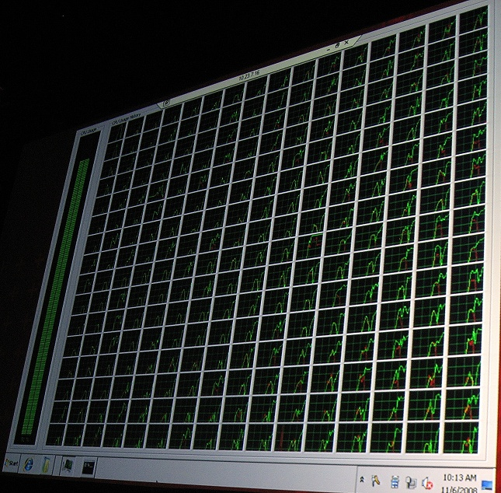
256 Processor System

Slide 83
Processes, Threads, and Groups
By default, processes are affinitized to have all threads run in a single group
Thread can be affinitized to only the CPUs within a single group
Group Assignment:
Processes assigned group and ideal node round-robin
By default, thread assigned ideal CPU from process’ ideal node round-robin
Legacy affinity APIs apply at group level
Application can take advantage of > 64 LPs by assigning threads to a different group than default

Slide 84
NUMA Enhancements
Support for NUMA has improved every release
Scheduler more NUMA aware
Memory Manager more NUMA aware
New APIs for:
Getting relationships between caches, cores, sockets, nodes, and groups (topology)
Mapping LPs to NUMA nodes and vice versa
Getting distance between NUMA nodes
Services can specify ideal NUMA node

Slide 85
Removal of the Memory Manager PFN Lock
Windows tracks the state of pages in physical memory
In use (in a working set)
Not assigned to a working set (on one of several paging lists: free, zero, modified, standby…)
Before, all page state changes protected by global PFN (Physical Frame Number) lock
Now, the PFN lock is gone
Pages are now locked individually
Improves scalability for applications that manage large amounts of memory

Slide 86
Removal of Other Major Locks
Cache Manager Virtual Address Control Block (VACB) lock
Not completely removed, but gone from common code paths
Improves scaling of applications that perform intensive cached file I/O
Object Manager Type lock
Improves scaling of workloads that modify kernel objects (synchronization, files, registry keys)

Slide 87
Removal of the Dispatcher Lock
Locks serialize access to data structures
Prevents multiple threads from simultaneously modifying data
Inhibits scaling because threads must wait for their turn (contention)
Scheduler Dispatcher lock hottest on server workloads
Lock protects all thread state changes (wait, unwait)
To improve scaling, lock was removed
Each object protected by its own lock
Many operations are lock-free

Slide 88
Scaling Without the Dispatcher Lock
1.7x scaling going from 128 to 256 LPs:
OLTP Workload Throughput
Transactions/minute

Slide 89
Summary and More Information
Lots of exciting kernel changes in Windows 7 and Server 2008 R2!
There’s more that I didn’t have time to cover
Faster, more scalable, more secure
Further reading:
MSDN (SDK and WDK) describes new user and kernel mode APIs
Look for my upcoming kernel changes blog post series
Windows Internals 6th Edition (2010)

Slide 90
YOUR FEEDBACK IS IMPORTANT TO US!
Please fill out session evaluation forms online at
MicrosoftPDC.com

Slide 91
Learn More On Channel 9
Expand your PDC experience through Channel 9
Explore videos, hands-on labs, sample code and demos through the new Channel 9 training courses
channel9.msdn.com/learn
Built by Developers for Developers….

